Slide 1
Data Analysis
~ Anjali gadhiya

Slide 2
What is Data Analysis
Convert raw data into actionable insights.
A data analyst collects, cleans and interprets data set to answer a question or solve a problem.
Example:- If a company wants to see what a consumer rates their store, they would use a data analysis to gather that data.

Slide 3
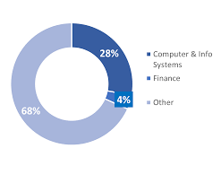
Which Faculty use Data Analyst
Media industry
Finance industry
Banking businesses
E-Commerce industry
Education industry

Slide 4
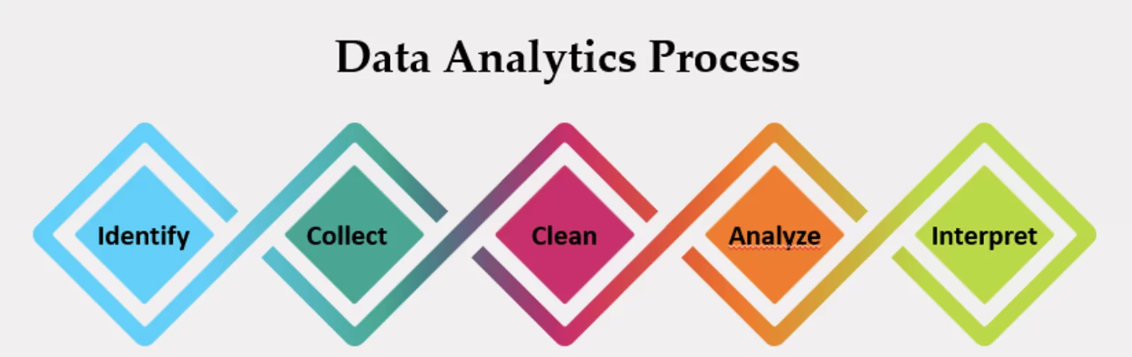
Process

Slide 5
Data Visualization Tools
Microsoft Excel
SQL
Python
Tableau
Microsoft Power Bi

Slide 6
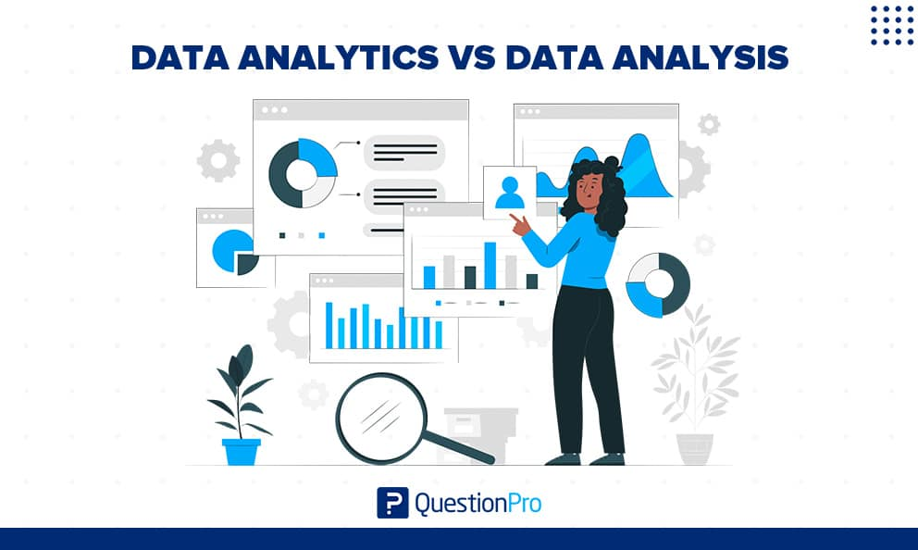
What is the different between Data Analysis and Data Analytics
Analysis is examining past events.
while analytics to make you something past and present data to predict future outcomes.

Slide 7
Why Data Analysis important
It helps organizations harness the power of data, enabling them to make decisions, optimize processes, and gain a competitive edge
Data analysis is important because it helps uncover insights, trends, and patterns hidden within data, which can inform better decision-making and problem-solving.

Slide 8
Welcome

